Slide 1

Introduction to Data Science
(S1-23_DSECLZG532)
Webinar 1
Python Basics & Data Pre-processing

Slide 2

Python Basics

Slide 3
1. PYTHON BASICS
1.1 What is Python?
1.2 Variables and data types in Python
1.3 Python Operators
1.4 Conditions and Loops
1.5 Functions in Python
1.6 Import in Python
1.7 Strings in Python
1.8 File Handling in Python
1.9 Python Collections
1.10 Python Classes/Objects

Slide 4
1.1 What is Python?
Python is easy to use, powerful, and versatile, making it a great choice for beginners and experts alike."
It is a cross platform programming language created in 1991 by Guido Van Rossum.
It is freely usable even for commercial use.
It has in-built mathematical libraries and functions, making it easier to calculate mathematical problems and to perform data analysis.
For data scientists working with Object-Oriented Programming (OOP) in Python, these built-in class attributes can be useful in various ways. For example, the doc attribute can be used to store the documentation for the class and its methods, making it easier for others to understand and use the code.

Slide 5
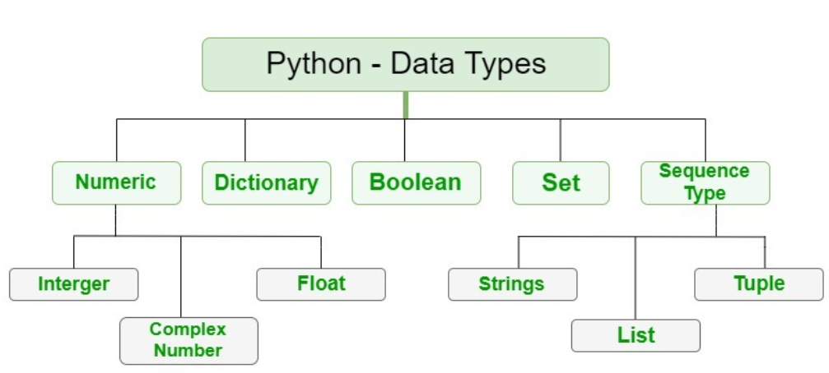
1.2 Data types in Python
Variables can store data of different types, and different types can do different things.
Python has the following data types built-in by default:
Text Type: str
Numeric Types: int, float, complex
Sequence Types: list, tuple, range
Mapping Type: dict
Set Types: set, frozenset
Boolean Type: bool
Binary Types: bytes, bytearray, memoryview

Slide 6
1.2 Variables in Python
A Python variable is a name given to a memory location. They are containers that store values.
Data values can be of various types: Text, Numeric, Sequence, Mapping, Set, Boolean and Binary
Python is not “statically typed”. Python variables do not need explicit declaration, it happens when value is assigned to a variable.
Data Values are assigned to variables using "=".
Example:
x = 5
x = "Python"

Slide 7
1.3 Operators
Python divides the operators in the following groups:
Arithmetic operators
Assignment operators
Comparison operators
Logical operators
Identity operators
Membership operators
Bitwise operators

Slide 8
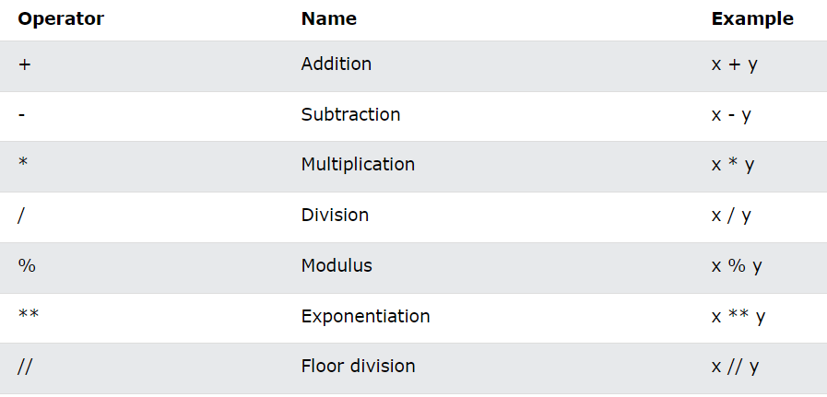
1.3 Operators
Arithmetic operators

Slide 9
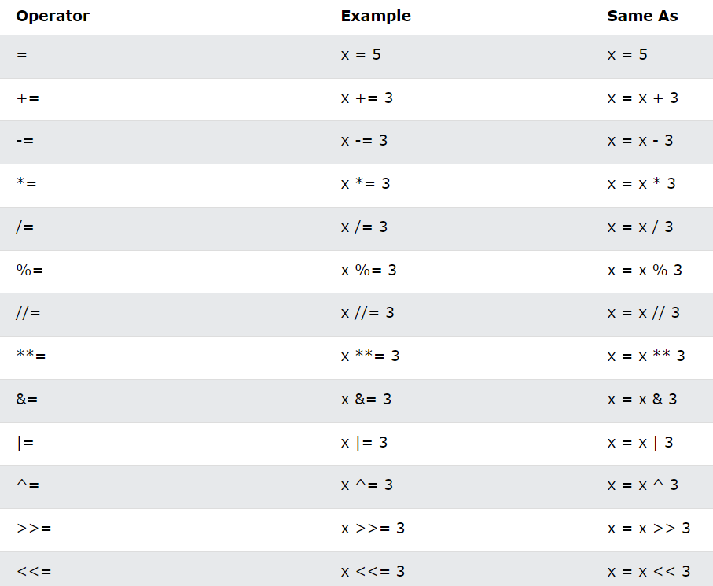
1.3 Operators
Assignment operators

Slide 10
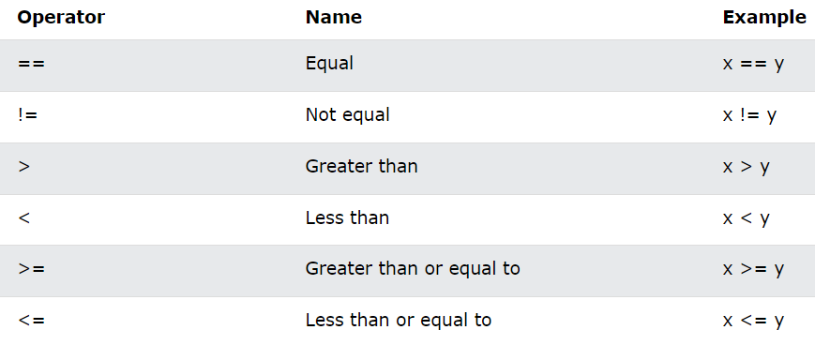
1.3 Operators
Comparison operators

Slide 11
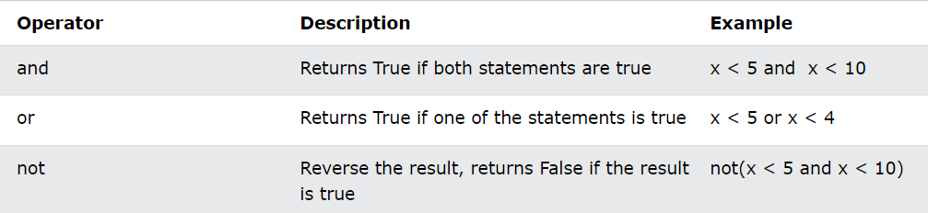
1.3 Operators
Logical operators

Slide 12
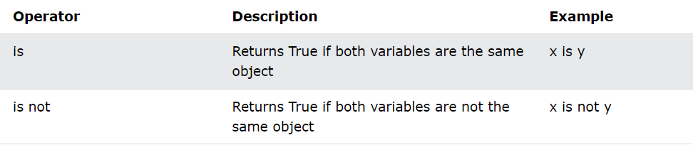
1.3 Operators
Identity operators

Slide 13
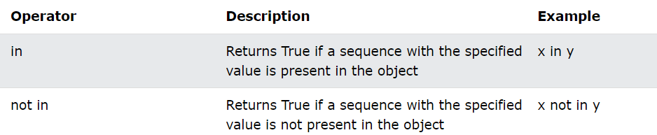
1.3 Operators
Membership operators

Slide 14
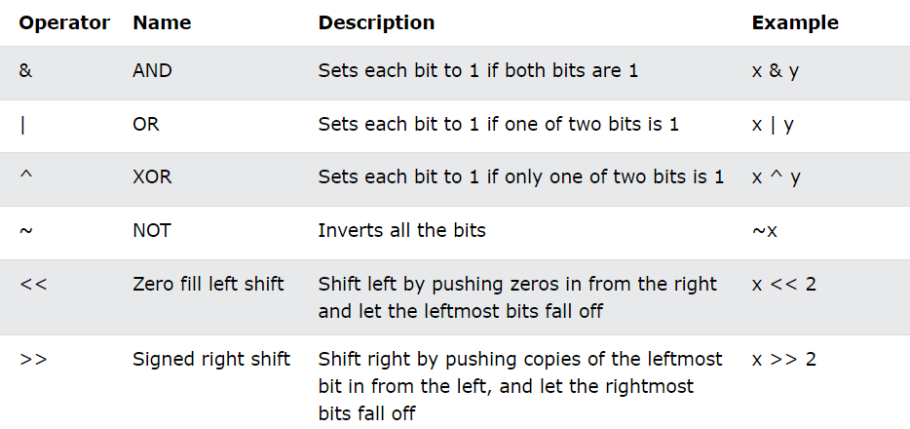
1.3 Operators
Bitwise operators

Slide 15
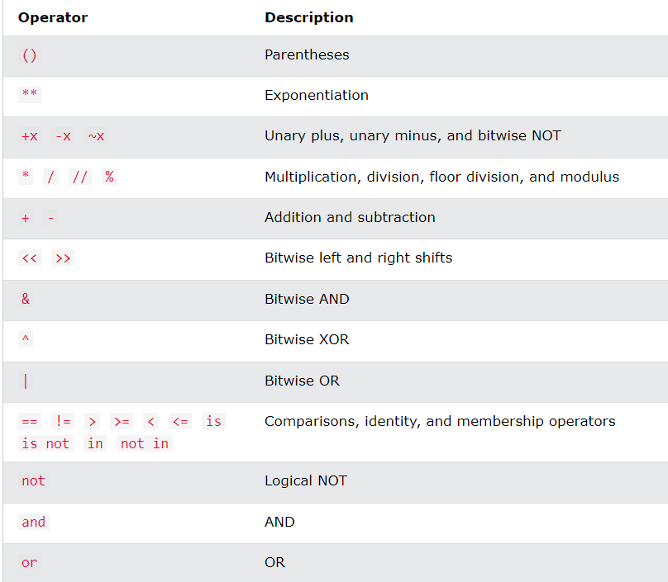
1.3 Operators
Operator precedence

Slide 16
1.4 Conditional statements in Python
if condition
The if statement allows to execute a block of code if a certain condition is true.
Syntax
if condition:
# code to execute if condition is true
Example
num = 5
if num > 0:
print("The number is positive.")

Slide 17
1.4 Conditional statements in Python
else statement
The else statement allows to execute a different block of code if the if condition is False.
Syntax
if condition:
# code to execute if condition is true
else:
# code to execute if condition is false
Example
num = -5
if num > 0:
print("The number is positive.")
else:
print("The number is negative.")

Slide 18
1.4 Conditional statements in Python
elif statement
The elif statement allows to check multiple conditions in sequence, and execute different code blocks depending on which condition is true.
Syntax
if condition1:
# code to execute if condition1 is true
elif condition2:
# code to execute if condition1 is false and condition2 is true
elif condition3:
# code to execute if condition1 and condition2 are false, and condition3 is true
else:
# code to execute if all conditions are false

Slide 19
1.4 Conditional statements in Python
score = 85
if score >= 90:
grade = "A"
elif score >= 80:
grade = "B"
elif score >= 70:
grade = "C"
elif score >= 60:
grade = "D"
else:
grade = "F"
print("Your grade is:", grade)

Slide 20
1.4 Looping statements in Python
A looping statement contains instructions that continually repeat until a certain condition is reached.
Looping simplifies complicated problems into smooth ones. It allows programmers to modify the flow of the program so that rather than writing the same code, again and again, programmers are able to repeat the code a finite number of times.
Python programming language provides the two types of loops to handle looping requirements.
While loop
For loop

Slide 21
1.4 Looping statements in Python
While loop
The while loop is to be used in situations where the number of iterations is unknown at first. The block of statements is executed in the while loop until the condition specified in the while loop is satisfied. It is also called a pre-tested loop.
In Python, the while loop executes the statement or group of statements repeatedly while the given condition is True. And when the condition becomes false, the loop ends and moves to the next statement after the loop.
Syntax
While condition:
statement(s)

Slide 22
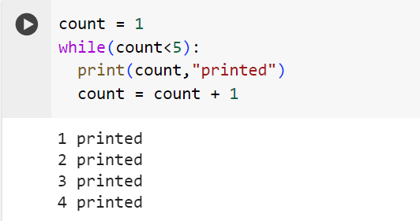
1.4 Looping statements in Python
While loop example
count = 1
while (count < 5):
print(count, " printed")
count = count + 1

Slide 23
1.4 Looping statements in Python
For loop
The for loop is used in the case where a programmer needs to execute a part of the code until the given condition is satisfied. The for loop is also called a pre-tested loop. It is best to use for loop if the number of iterations is known in advance.
It can be used to iterate over a range and iterators.
Syntax
for variable in sequence:
statements(s)

Slide 24
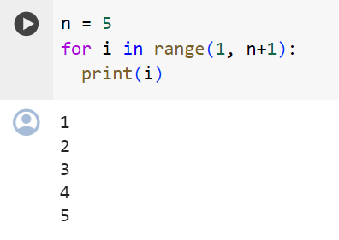
1.4 Looping statements in Python
For loop example
n = 4
for i in range(1, n):
print(i)

Slide 25
1.4 Branching statements in Python
Branching statements in Python are used to change the normal flow of execution based on some condition.
Python provides three branching statements break, continue and return.
In Python pass also a branching statement, but it is a null statement.
The return branching statement is used to explicitly return from a method.
break branching statement is used to break the loop and transfer control to the line immediately outside of the loop.
continue branching statement is used to escape current execution and transfers control back to the start of the loop.

Slide 26
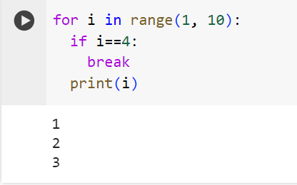
1.4 Branching statements in Python
# break Statement Example
for i in range(1, 10):
if i == 4:
break
print(i)

Slide 27
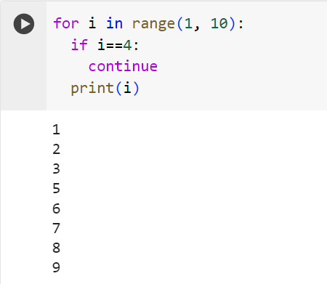
1.4 Branching statements in Python
# continue Statement Example
for i in range(1, 10):
if i == 4:
continue
print(i)

Slide 28
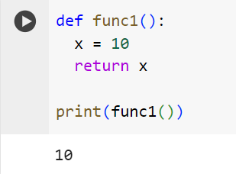
1.4 Branching statements in Python
Return statement
The return statement is used inside a function to exit it and return a value.
# return Statement Example
def func1():
x = 10
return x
print(func1())

Slide 29
1.5 Functions in Python
A function is a block of code that performs a specific task.
There are two types of function in Python programming:
Standard library functions - These are built-in functions in Python that are available to use.
User-defined functions - We can create our own functions based on our requirements.
Syntax
def function_name(arguments):
# function body
return

Slide 30
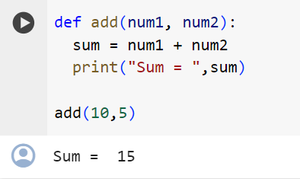
1.5 Functions in Python
Example
def add(num1, num2):
sum = num1 + num2
print('Sum: ',sum)
add(10,5)

Slide 31
1.6 Import in Python
The Python import statement imports code from one module into another program.
It is possible to import all the code from a module by specifying the import keyword followed by the module.
import statements appear at the top of a Python file, beneath any comments that may exist. This is because importing modules or packages at the top of a file makes the structure of your code clearer.
Syntax
import module

Slide 32
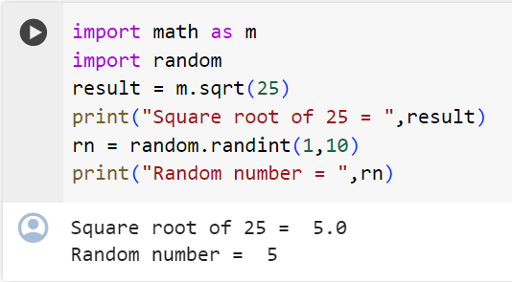
1.6 Import in Python
Example
import math as m
import random
result = m.sqrt(25)
print("Square root of 25:", result)
rn = random.randint(1, 10)
print("Random Number:", rn)

Slide 33
1.7 Strings in Python
A string is a sequence of characters. Strings in Python can be created using single quotes or double quotes or even triple quotes.
'hello' is the same as "hello".
Python does not have a character data type, a single character is simply a string with a length of 1. Individual characters of a String can be accessed by using the method of Indexing.
Indexing allows negative address references to access characters from the back of the String, e.g. -1 refers to the last character, -2 refers to the second last character, and so on.
P | Y | T | H | O | N
0 | 1 | 2 | 3 | 4 | 5
-6 | -5 | -4 | -3 | -2 | -1

Slide 34
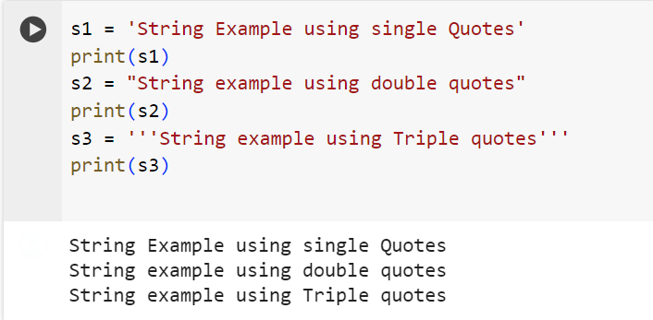
1.7 Strings in Python
s1 = 'String Example using single Quotes'
print(s1)
s2 = "String example using double quotes"
print(s2)
s3 = '''String example using Triple quotes'''
print(s3)

Slide 35
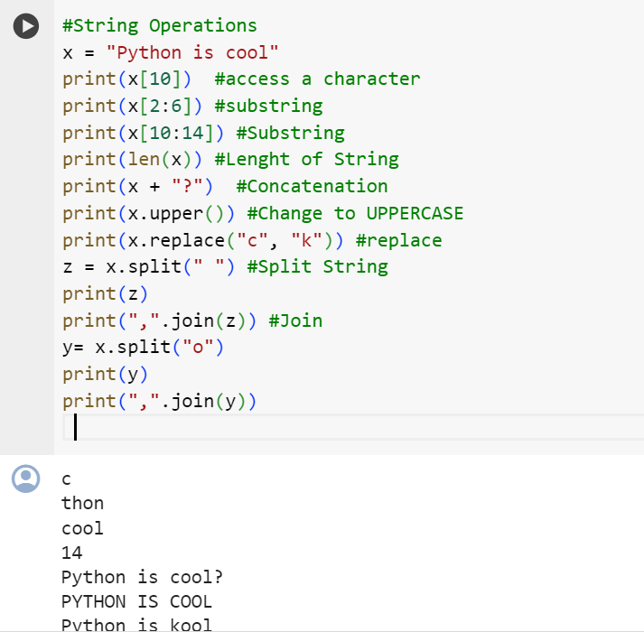
1.7 Strings in Python
#String Operations
x = "Python is cool"
print(x[10]) #access a character
print(x[2:6]) #substring
print(x[10:14]) #Substring
print(len(x)) #Lenght of String
print(x + "?") #Concatenation
print(x.upper()) #Change to UPPERCASE
print(x.replace("c", "k")) #replace
z = x.split(" ") #Split String
print(z)
print(",".join(z)) #Join
y= x.split("o")
print(y)
print(",".join(y))

Slide 36
1.8 File handling in Python
File handling is an important part of any web application.
Python has several functions for creating, reading, updating, and deleting files. The key function for working with files in Python is the open() function.
The open() function takes two parameters; filename, and mode.
There are four different methods (modes) for opening a file: "r" - Read - Default value. Opens a file for reading, error if the file does not exist. "a" - Append - Opens a file for appending, creates the file if it does not exist. "w" - Write - Opens a file for writing, creates the file if it does not exist. "x" - Create - Creates the specified file, returns an error if the file exists. In addition you can specify if the file should be handled as binary or text mode. "t" - Text - Default value. Text mode. "b" - Binary - Binary mode (e.g. images).

Slide 37
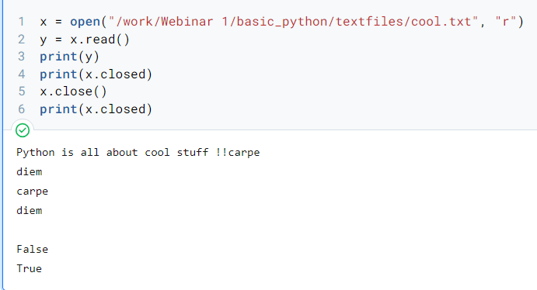
1.8 File handling in Python
x = open("/work/Webinar 1/basic_python/textfiles/cool.txt", "r")
y = x.read()
print(y)
print(x.closed)
x.close()
print(x.closed)

Slide 38
1.9 Python Collections
There are four collection data types in the Python programming language:
List is a collection which is ordered and changeable. Allows duplicate members. Written with square brackets.
Tuple is a collection which is ordered and unchangeable. Allows duplicate members. Written with round brackets.
Set is a collection which is unordered and unindexed. No duplicate members. Written with curly brackets.
Dictionary is a collection which is unordered, changeable and indexed. No duplicate members. Written with curly brackets having key-value pairs.

Slide 39
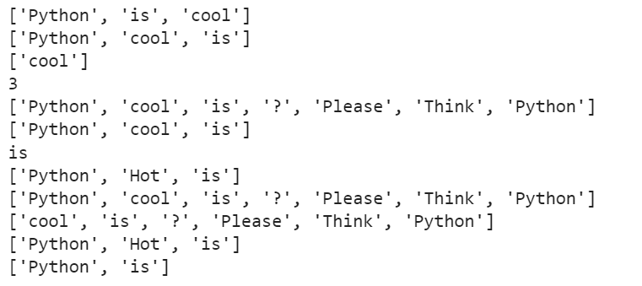
1.9 Python Collections
x = ["Python", "is", "cool"]
print(x)
x.sort()
print(x)
y = x[1:2]
print(y)
z = len(x)
print(z)
a = x + ["?", "Please", "Think", "Python"]
print(a)
print(x)
print(x[2])
x[1] = "Hot"
print(x)
print(a)
a.remove("Python")
print(a)
print(x)
x.pop(1)
print(x)

Slide 40
1.10 Python Classes/Objects
Python is an object oriented programming language.
Almost everything in Python is an object, with its properties and methods.
A Class is like an object constructor, or a "blueprint" for creating objects.
To create a class, use the keyword "CLASS".
While in functions we encapsulate a set of instructions, in classes we encapsulate object's methods and atributes!
A class can use other classes as BASE.

Slide 41
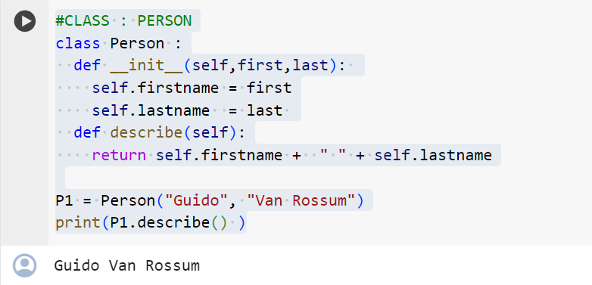
1.10 Python Classes/Objects
#CLASS : PERSON
class Person :
def __init__(self,first,last):
self.firstname = first
self.lastname = last
def describe(self):
return self.firstname + " " + self.lastname
P1 = Person("Guido", "Van Rossum")
print(P1.describe() )

Slide 42
Data Preprocessing

Slide 43
2. DATA PREPROCESSING
2.1 Data Preprocessing
2.2 Importing the libraries
2.3 Importing the Dataset
2.4 Case study: CHURN

Slide 44
2.1 Data Preprocessing
Data Preprocessing refers to the steps applied to make data more suitable for data mining.
The steps used for Data Preprocessing usually fall into two categories:
selecting data objects and attributes for the analysis.
creating/changing the attributes.

Slide 45
2.2 Importing the libraries
# libraries
import numpy as np # used for handling numbers
import pandas as pd # used for handling the dataset
from sklearn.impute import SimpleImputer # used for handling missing data
from sklearn.preprocessing import LabelEncoder, OneHotEncoder # used for encoding categorical data
from sklearn.model_selection import train_test_split # used for splitting training and testing data
from sklearn.preprocessing import StandardScaler # used for feature scaling

Slide 46
2.2 Importing the libraries
If there is any import errors, install those packages explicitly using pip command as follows:
pip install <package-name>

Slide 47
2.3 Importing the Dataset
dataset = pd.read_csv('/Data.csv') # to import the dataset into a variable
# Splitting the attributes into independent and dependent attributes
X = dataset.iloc[:, :-1].values # attributes to determine dependent variable / Class
Y = dataset.iloc[:, -1].values # dependent variable / Class

Slide 48
2.3 Importing the Dataset
#import libraries
#!pip install xlrd
!pip install openpyxl
import pandas as pd
#Loading Data from the souce file -> auto.csv
headers = ['symboling', 'normalized-losses','make','fuel-type','aspiration','doors', 'body-style', 'drive-wheels', 'engine-location', 'wheel-base', 'length', 'width', 'height', 'curb-weight', 'engine-type', 'num-of-cylinders', 'engine-size', 'fuel-system', 'bore', 'stroke', 'compression-ratio', 'horsepower', 'peak-rpm', 'city-mpg', 'highway-mpg', 'price']
df = pd.read_csv('/work/Webinar 1/data_preprocessing/dataset/auto.csv',header=0, names=headers)
df

Slide 49
2.3 Importing the Dataset
#Loading data from the souce file -> auto.xlsx
df_excel = pd.read_excel('/work/Webinar 1/data_preprocessing/dataset/auto.xlsx',sheet_name='auto',header=0, names=headers)
df_excel
df.shape
df.dtypes
df.info()
df.isnull().sum()
df
df.isnull().mean()

Slide 50
2.3 Importing the Dataset
threshold = 0.5
#Dropping columns with missing value rate higher than threshold
df = df[df.columns[df.isnull().mean() < threshold]]
df

Slide 51
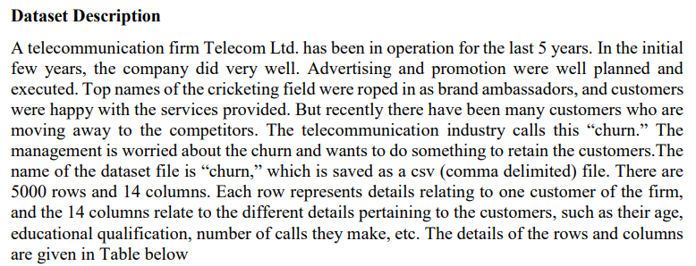
2.4 Case Study : CHURN

Slide 52
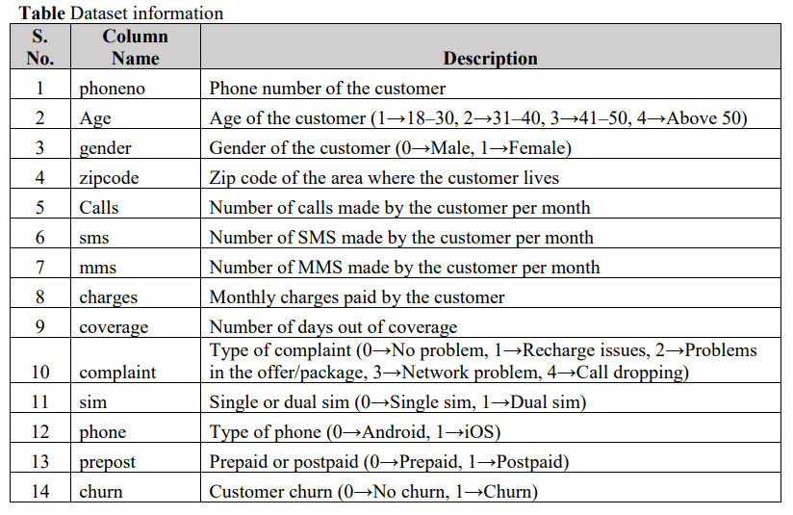
2.4 Case Study : CHURN

Slide 53
2.4 Case Study : CHURN
import pandas as pd
import numpy as np
import pandas as pd
import numpy as np
#Load the csv file
churn = pd.read_csv('/content/Churn.csv')
churn

Slide 54
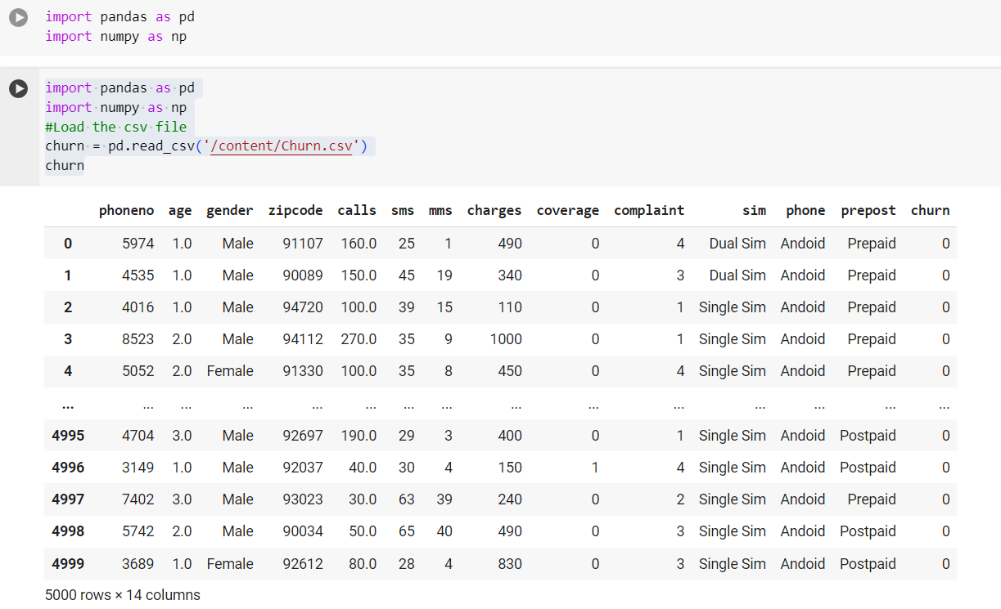
2.4 Case Study : CHURN

Slide 55
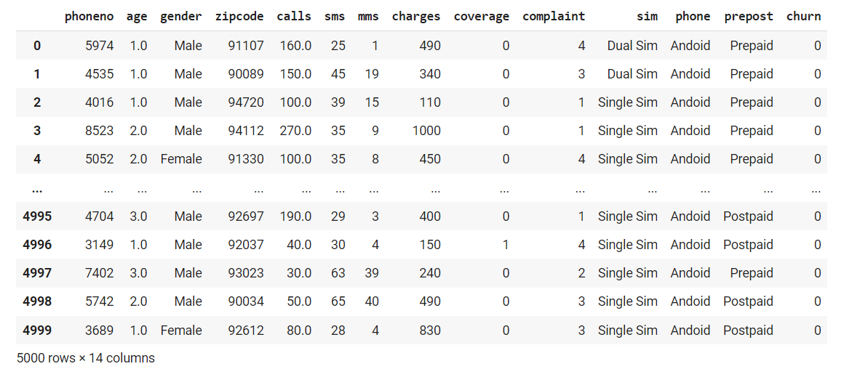
2.4 Case Study : CHURN
import pandas as pd
churn = pd.read_csv('/content/Churn.csv', na_values=["??","????"])
churn

Slide 56
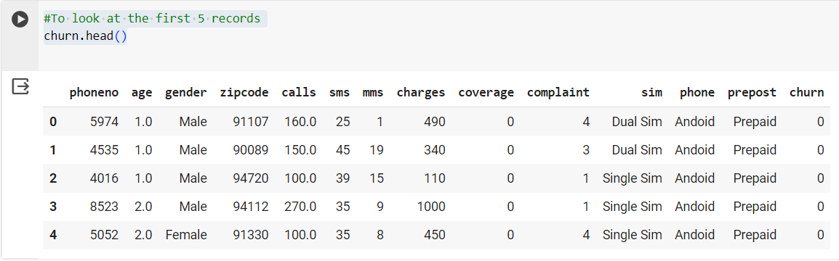
2.4 Case Study : CHURN
#To look at the first 5 records
churn.head()

Slide 57
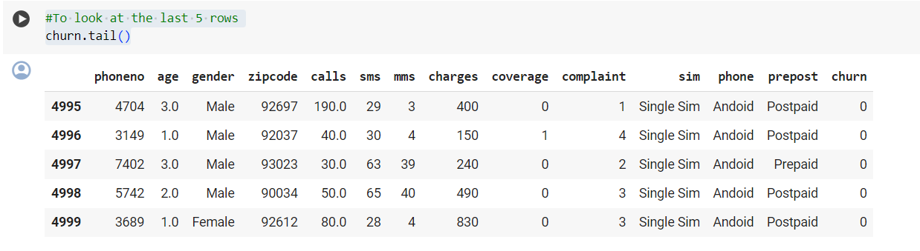
2.4 Case Study : CHURN
#To look at the last 5 rows
churn.tail()

Slide 58
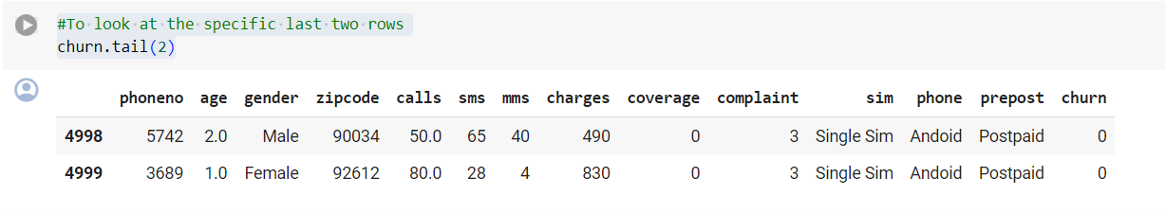
2.4 Case Study : CHURN
#To look at the specific last two rows
churn.tail(2)

Slide 59
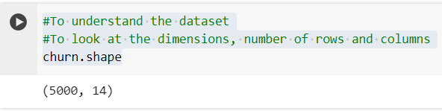
2.4 Case Study : CHURN
#To understand the dataset
#To look at the dimensions, number of rows and columns
churn.shape

Slide 60
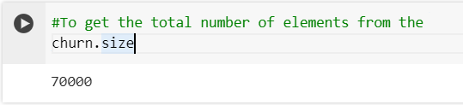
2.4 Case Study : CHURN
#To get the total number of elements from the
churn.size

Slide 61
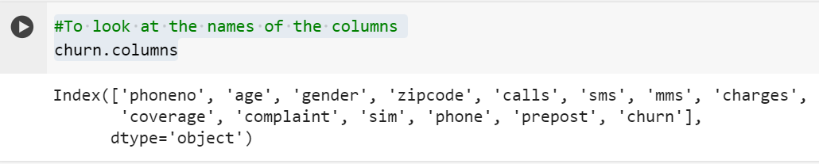
2.4 Case Study : CHURN
#To look at the names of the columns
churn.columns

Slide 62
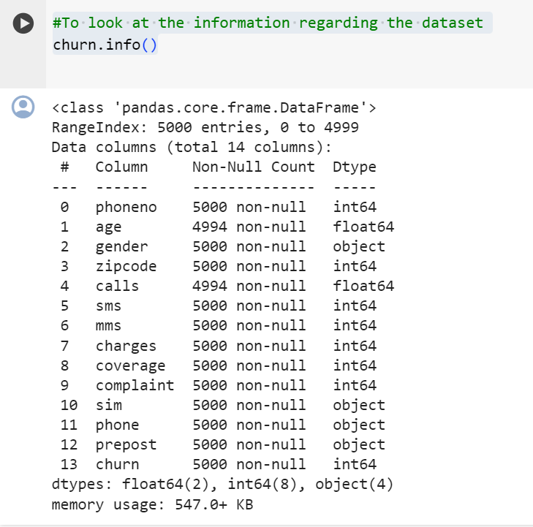
2.4 Case Study : CHURN
#To look at the information regarding the dataset
churn.info()

Slide 63
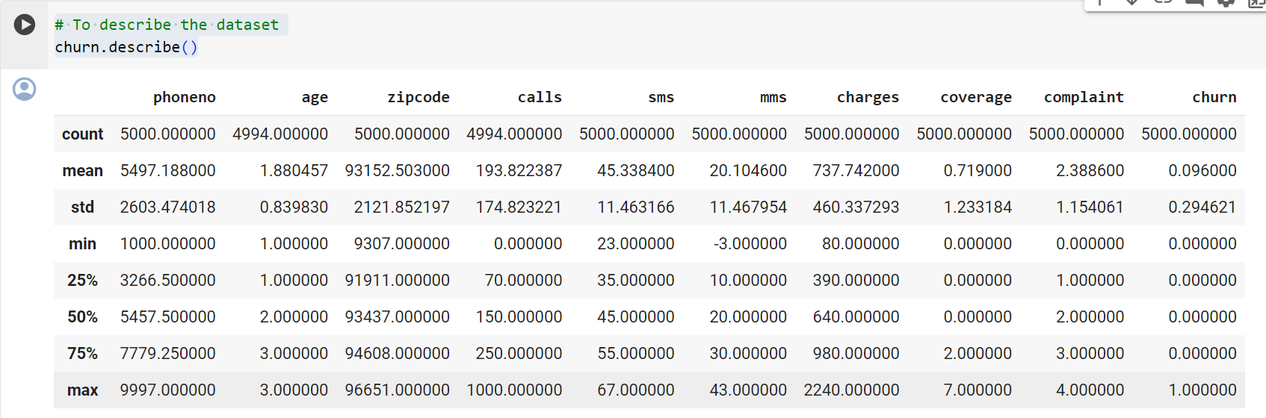
2.4 Case Study : CHURN
# To describe the dataset
churn.describe()

Slide 64
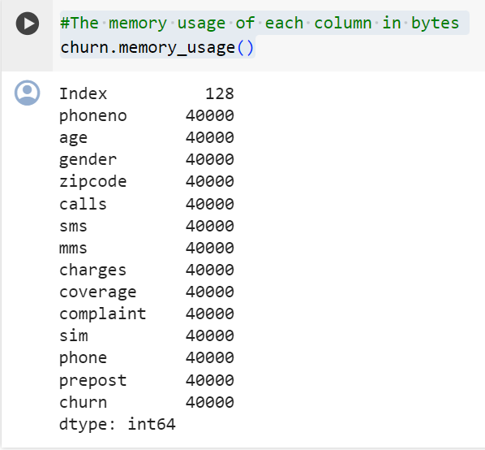
2.4 Case Study : CHURN
#The memory usage of each column in bytes
churn.memory_usage()

Slide 65
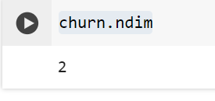
2.4 Case Study : CHURN
churn.ndim

Slide 66
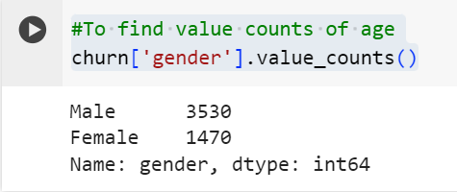
2.4 Case Study : CHURN
#To find value counts of age
churn['gender'].value_counts()

Slide 67
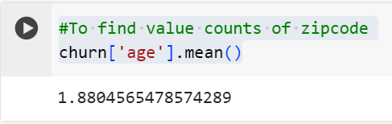
2.4 Case Study : CHURN
#To find value counts of zipcode
churn['age'].mean()

Slide 68
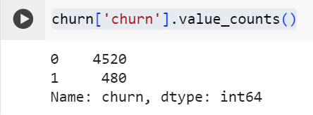
2.4 Case Study : CHURN
churn['churn'].value_counts()

Slide 69
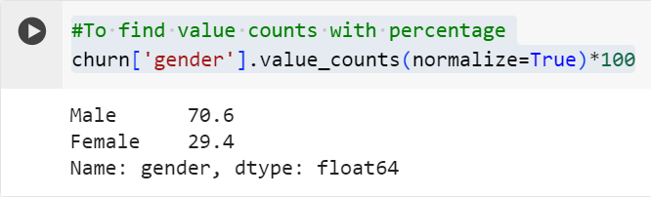
2.4 Case Study : CHURN
#To find value counts with percentage
churn['gender'].value_counts(normalize=True)*100

Slide 70
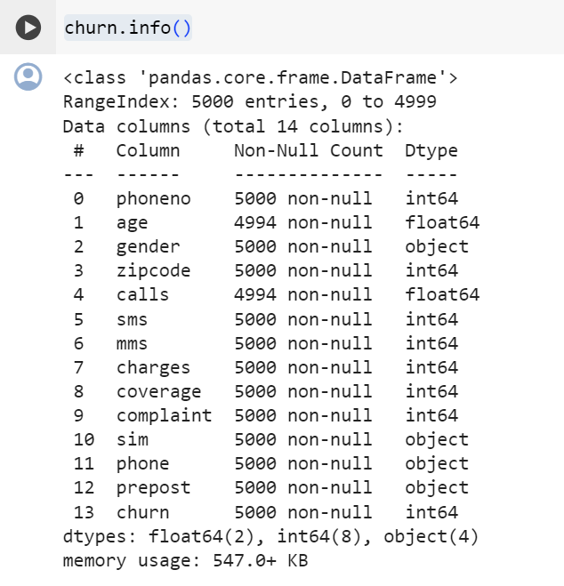
2.4 Case Study : CHURN
# To recheck using the info function if the categorical variables have been converted
churn.info()

Slide 71
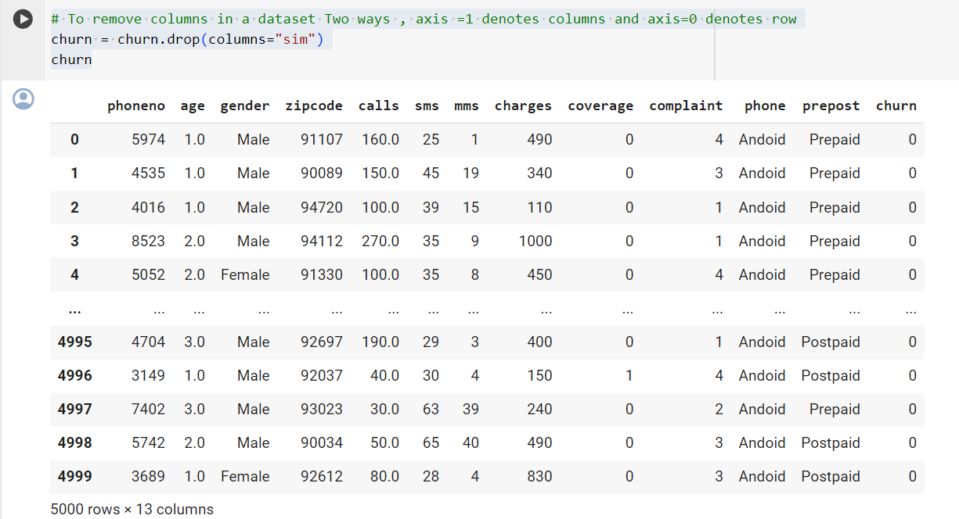
2.4 Case Study : CHURN
# To remove columns in a dataset Two ways , axis =1 denotes columns and axis=0 denotes row
churn = churn.drop(columns="sim")
churn

Slide 72
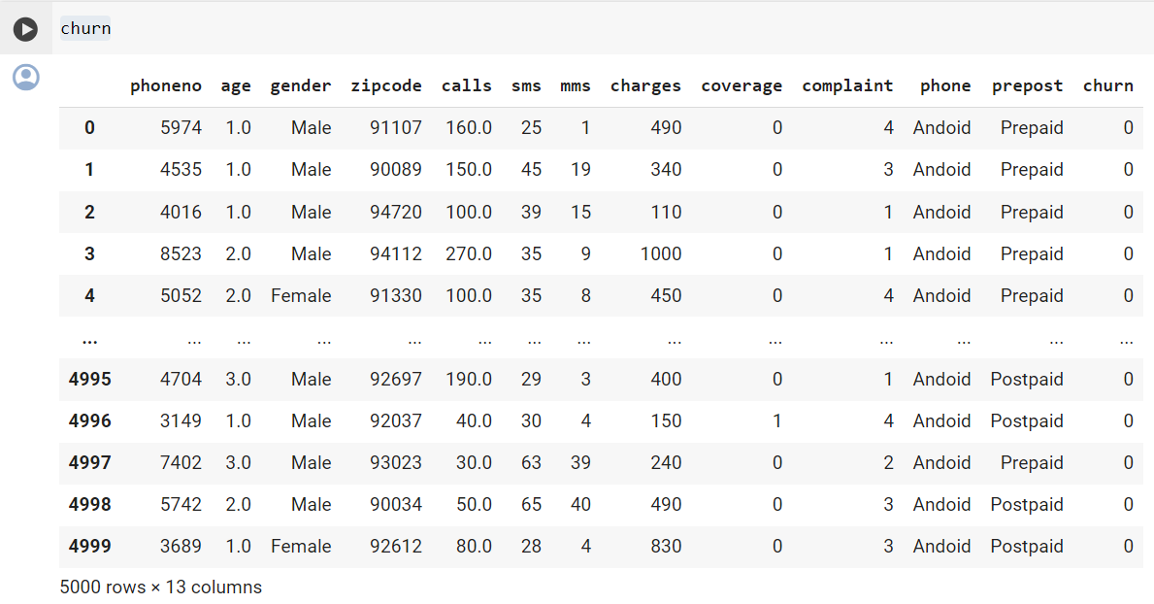
2.4 Case Study : CHURN
churn

Slide 73
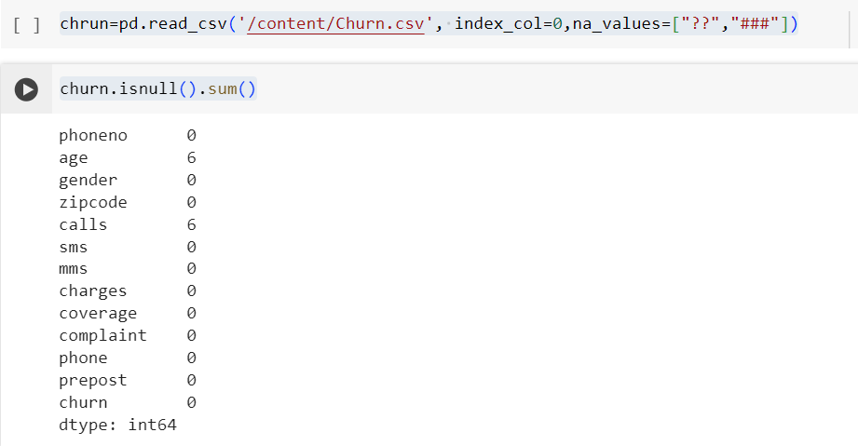
2.4 Case Study : CHURN
chrun=pd.read_csv('/content/Churn.csv', index_col=0,na_values=["??","###"])
churn.isnull().sum()

Slide 74
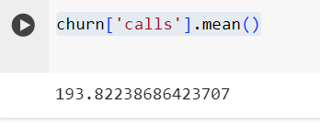
2.4 Case Study : CHURN
churn['calls'].mean()

Slide 75
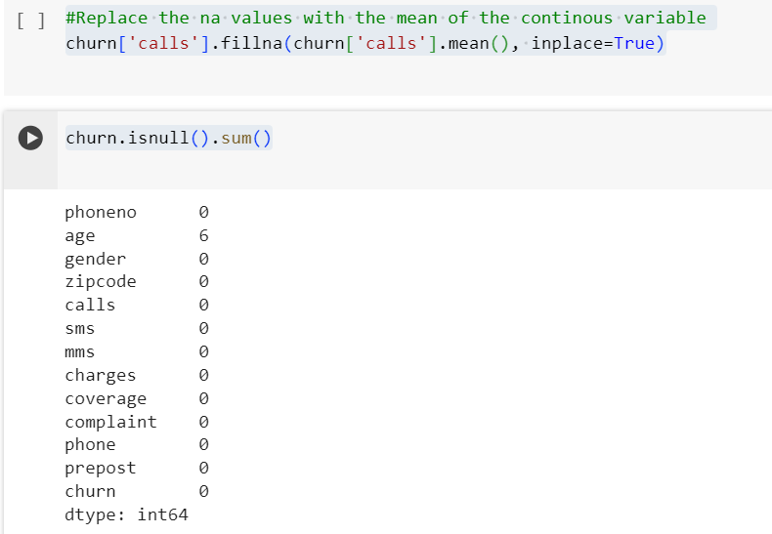
2.4 Case Study : CHURN
#Replace the na values with the mean of the continous variable
churn['calls'].fillna(churn['calls'].mean(), inplace=True)
churn.isnull().sum()

Slide 76
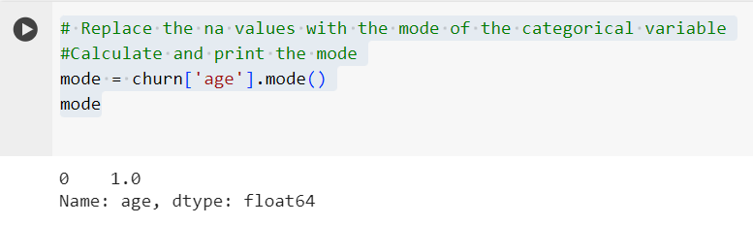
2.4 Case Study : CHURN
# Replace the na values with the mode of the categorical variable
#Calculate and print the mode
mode = churn['age'].mode()
mode

Slide 77
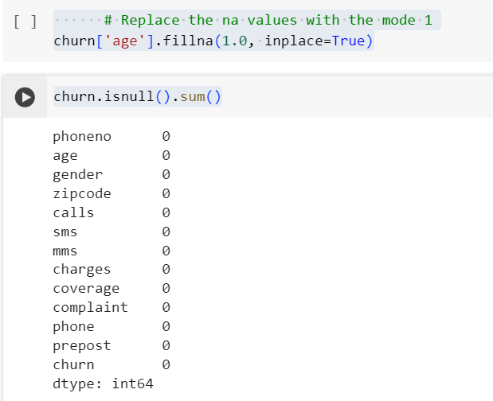
2.4 Case Study : CHURN
# Replace the na values with the mode 1
churn['age'].fillna(1.0, inplace=True)
churn.isnull().sum()

Slide 78
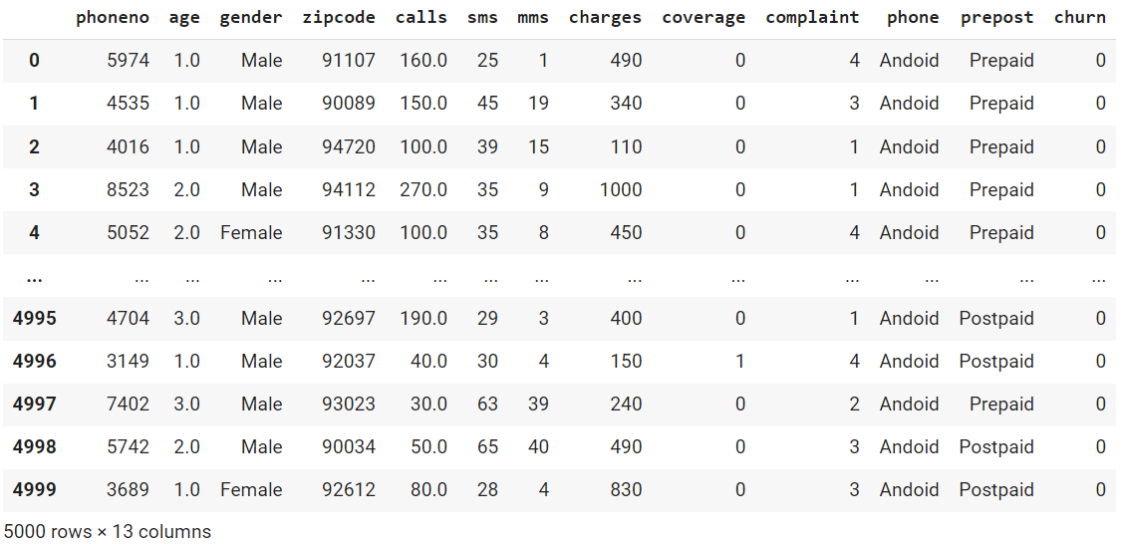
2.4 Case Study : CHURN
churn

Slide 79
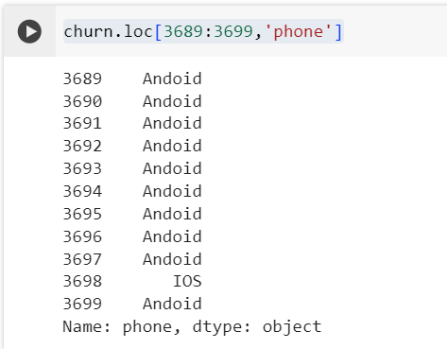
2.4 Case Study : CHURN
churn.loc[3689:3699,'phone']

Slide 80
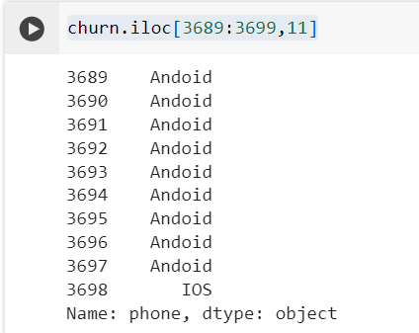
2.4 Case Study : CHURN
churn.iloc[3689:3699,11]

Slide 81

2.4 Case Study : CHURN
print(np.unique(chrun['calls']))

Slide 82


2.4 Case Study : CHURN
print(np.unique(chrun['age’]))
churn.at[1050,'age']

Slide 83
2.4 Case Study : CHURN
To plot Histograms of continous variables
import matplotlib.pyplot as plt import seaborn as sn %matplotlib inline
plt.hist(churn['calls’])
import matplotlib.pyplot as plt
import seaborn as sn
plt.hist(churn['calls'],bins=10)
plt.xlabel('hello')

Slide 84

2.4 Case Study : CHURN

Slide 85

2.4 Case Study : CHURN
plt.hist(churn.columns)

Slide 86

2.4 Case Study : CHURN
plt.hist(churn['sms'])

Slide 87

2.4 Case Study : CHURN
#To plot countplots of categorical variables
sn.countplot(x='age',data = churn);

Slide 88

2.4 Case Study : CHURN
sn.countplot(x='age',data = churn);

Slide 89

2.4 Case Study : CHURN
sn.countplot(x='complaint',data = churn)
plt.xlabel('hello')
plt.ylabel('hi')
plt.title('count')

Slide 90

2.4 Case Study : CHURN
sn.countplot(x='prepost',data = churn);
churn['prepost'].value_counts()

Slide 91

2.4 Case Study : CHURN
#Boxplot of continous variables
sn.boxplot(churn['calls'])

Slide 92
2.4 Case Study : CHURN
# To replace any value greater than 95th quantile value with the 95th quantile value which
churn['calls'] = np.where(churn['calls'] > 600, 600, churn['calls'])
# To replace any value lesser than 5th quantile value with the 5th quantile value which is
churn['calls'] = np.where(churn['calls'] < 30, 30, churn['calls'])
# To plot the boxplot after removing outliers
sn.boxplot(churn['calls']);

Slide 93

2.4 Case Study : CHURN

Slide 94

2.4 Case Study : CHURN
sn.boxplot(churn['sms'])

Slide 95

2.4 Case Study : CHURN
sn.boxplot(churn['charges'])

Slide 96

2.4 Case Study : CHURN
sn.boxplot(churn['coverage']);

Slide 97
2.4 Case Study : CHURN
# To replace any value greater than 95th quantile value with the 95th quantile value which
churn['charges'] = np.where(churn['charges'] > 1700, 1700, churn['charges'])
# To replace any value lesser than 5th quantile value with the 5th quantile value which is
churn['charges'] = np.where(churn['charges'] < 180, 180, churn['charges'])
# To plot the boxplot after removing outliers
sn.boxplot(churn['charges']);

Slide 98

2.4 Case Study : CHURN

Slide 99
2.4 Case Study : CHURN
#To replace any value greater than 95th quantile value with the 95th quantile value which
churn['coverage'] = np.where(churn['coverage'] > 3, 3, churn['coverage'])
# To replace any value lesser than 5th quantile value with the 5th quantile value which is
churn['coverage'] = np.where(churn['coverage'] < 0, 0, churn['coverage'])
# To plot the boxplot after removing outliers
sn.boxplot(churn['coverage']);

Slide 100

2.4 Case Study : CHURN

Slide 101
2.4 Case Study : CHURN
# To scale the data
# Import packages
from sklearn import preprocessing
min_max_scaler = preprocessing.MinMaxScaler()
churn[["sms","mms","calls","charges","coverage"]]=min_max_scaler.fit_transform(churn[["sms","mms","calls","charges","coverage"]])
churn.head()

Slide 102

2.4 Case Study : CHURN

Slide 103
Thank you

